Slide 1
Introduction to Computer Graphics with WebGL
Simple Shadows
Angel and Shreiner: Interactive Computer Graphics 7E © Addison-Wesley 2015

Slide 2
Flashlight in the Eye Graphics
When do we not see shadows in a real scene?
When the only light source is a point source at the eye or center of projection
  Shadows are behind objects and not visible
Shadows are a global rendering issue
  Is a surface visible from a source
  May be obscured by other objects
Angel and Shreiner: Interactive Computer Graphics 7E © Addison-Wesley 2015

Slide 3
Shadows in Pipeline Renders
Note that shadows are generated automatically by a ray tracers
  feeler rays will detect if no light reaches a point
  need all objects to be available
Pipeline renderers work an object at a time so shadows are not automatic
  can use some tricks: projective shadows
  multi-rendering: shadow maps and shadow volumes
Angel and Shreiner: Interactive Computer Graphics 7E © Addison-Wesley 2015

Slide 4
Projective Shadows
Oldest methods
  Used in flight simulators to provide visual clues
Projection of a polygon is a polygon called a shadow polygon
Given a point light source and a polygon, the vertices of the shadow polygon are the projections of the original polygon’s vertices from a point source onto a surface
Angel and Shreiner: Interactive Computer Graphics 7E © Addison-Wesley 2015

Slide 5
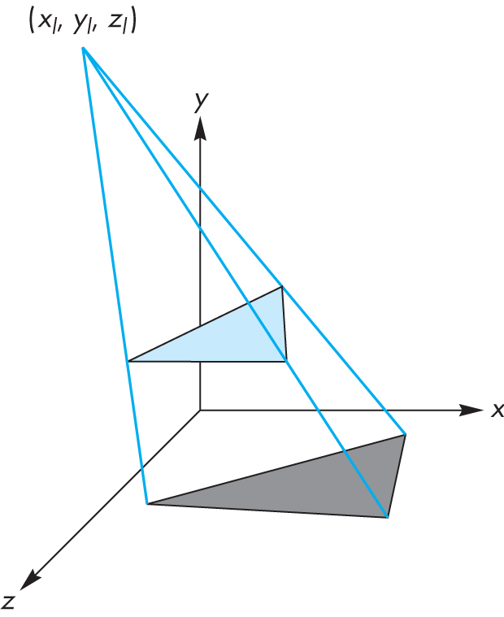
Shadow Polygon
Angel and Shreiner: Interactive Computer Graphics 7E © Addison-Wesley 2015

Slide 6
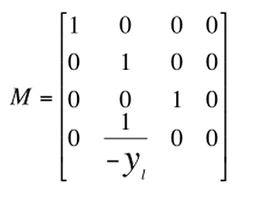
Computing Shadow Vertex
Source at (x_{l}, y_{l}, z_{l})
Vertex at (x, y, z)
Consider simple case of shadow projected onto ground at (x_{p}, 0, z_{p})
Translate source to origin with T(-x_{l}, -y_{l}, -z_{l})
Perspective projection
Translate back
Angel and Shreiner: Interactive Computer Graphics 7E © Addison-Wesley 2015

Slide 7
Shadow Process
  Put two identical triangles and their colors on GPU (black for shadow triangle)
  Compute two model view matrices as uniforms
  Send model view matrix for original triangle
  Render original triangle
  Send second model view matrix
  Render shadow triangle
  Note shadow triangle undergoes two transformations
  Note hidden surface removal takes care of depth issues
Angel and Shreiner: Interactive Computer Graphics 7E © Addison-Wesley 2015

Slide 8
Generalized Shadows
Approach was OK for shadows on a single flat surface
Note with geometry shader we can have the shader create the second triangle
Cannot handle shadows on general objects
Exist a variety of other methods based on same basic idea
We’ll pursue methods based on projective textures
Angel and Shreiner: Interactive Computer Graphics 7E © Addison-Wesley 2015

Slide 9
Shadow Maps
If we render a scene from a light source, the depth buffer will contain the distances from the source to nearest lit fragment.
We can store these depths in a texture called a depth map or shadow map
Note that although we don’t care about the image in the shadow map, if we render with some light, anything lit is not in shadow.
Form a shadow map for each source
Angel and Shreiner: Interactive Computer Graphics 7E © Addison-Wesley 2015

Slide 10
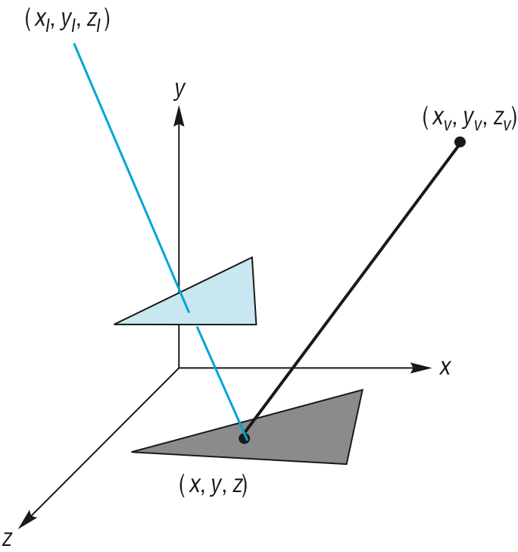
Shadow Mapping
Angel and Shreiner: Interactive Computer Graphics 7E © Addison-Wesley 2015

Slide 11
Final Rendering
During the final rendering we compare the distance from the fragment to the light source with the distance in the shadow map
If the depth in the shadow map is less than the distance from the fragment to the source the fragment is in shadow (from this source)
Otherwise we use the rendered color
Angel and Shreiner: Interactive Computer Graphics 7E © Addison-Wesley 2015

Slide 12
Implementation
Requires multiple renderings
We will look at render-to-texture later
  gives us a method to save the results of a rendering as a texture
  almost all work done in the shaders
Angel and Shreiner: Interactive Computer Graphics 7E © Addison-Wesley 2015

Slide 13
Shadow Volumes
light source
far clipping plane
shadow volume
near clipping plane
COP
Angel and Shreiner: Interactive Computer Graphics 7E © Addison-Wesley 2015

